Slide 1
HACK-FREE LAYOUTS WITH CSS GRID
DAVE BROCK
SOUTH FLORIDA CODE CAMP
FEBRUARY 10, 2018

Slide 2





ABOUT ME

Slide 3

.container {
display: grid;
}
<div class=“container”>
<div>1</div>
<div>2</div>
<div>3</div>
…
<div>9</div>
</div>
De
Defining a grid
You use the grid CSS display property to define a grid
When you do this, the direct children of the grid element become grid items
However, you still need to define the layout itself – by default the items will have one column each

Slide 4
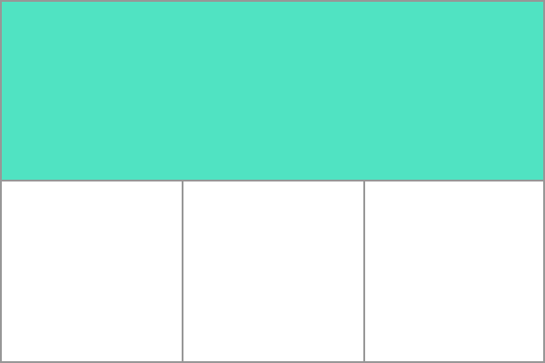
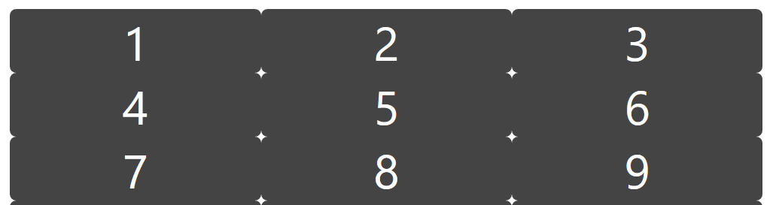
.container {
display: grid;
grid-template-columns: 200px 200px 200px;
}
<div class=“container”>
<div>1</div>
<div>2</div>
<div>3</div>
…
<div>9</div>
</div>
De
Grid tracks
We can now define rows and columns with grid-template- columns and grid-template-rows, which define grid tracks
A grid track is a space between any two lines on the grid
Here, we define three columns, each 200px wide. Each item takes up one grid cell
((grid images stolen borrowed from MDN)

Slide 5
.container {
display: grid;
grid-template-columns: repeat(3, 200px);
}
<div class=“container”>
<div>1</div>
<div>2</div>
<div>3</div>
…
<div>9</div>
</div>
De
Using the repeat() notation
To prevent duplication, you can use the repeat() notation
This takes two functions:
First – how many times you want to repeat what you are doing
Second – what you are repeating
((grid images stolen borrowed from MDN)

Slide 6
.container {
display: grid;
grid-template-columns: 1fr 1fr 1fr;
}
<div class=“container”>
<div>1</div>
<div>2</div>
<div>3</div>
…
<div>9</div>
</div>
De
Using the fr unit
The fr unit shows the available space in the container
This example creates three equal tracks that can grow and shrink based on the remaining space
((grid images stolen borrowed from MDN)

Slide 7
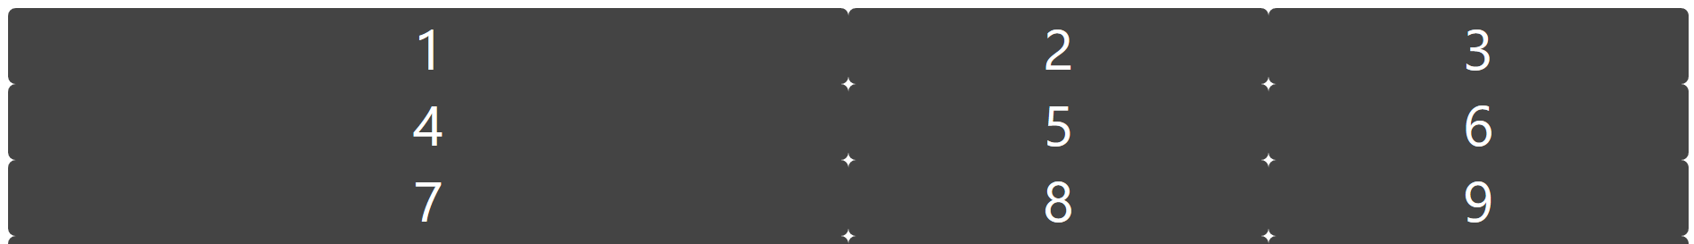
.container {
display: grid;
grid-template-columns: 2fr 1fr 1fr;
}
<div class=“container”>
<div>1</div>
<div>2</div>
<div>3</div>
…
<div>9</div>
</div>
De
Using the fr unit
The fr unit shows the available space in the container
In this example, we have the columns split into four – two parts to the first track, and one part each to the last two
((grid images stolen borrowed from MDN)

Slide 8

.container {
display: grid;
grid-template-columns: 2fr 1fr 1fr;
}
<div class=“container”>
<div>1</div>
<div>2</div>
<div>3</div>
…
<div>9</div>
</div>
De
Using the fr unit
Note that the fr unit uses available space
In this example, the first column takes up 500px, so this taken away from the available space
((grid images stolen borrowed from MDN)

Slide 9
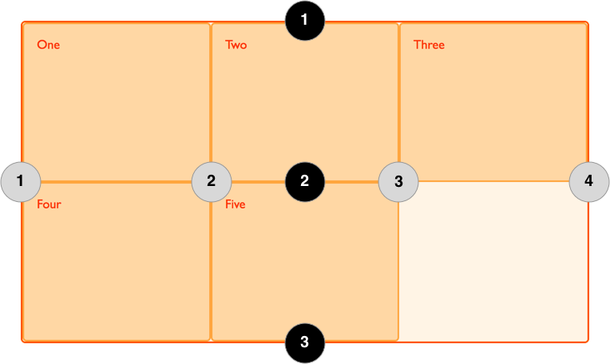
De
Grid lines
When we define grid tracks, we can use numbered lines to use when we position items
(
(grid images stolen borrowed from MDN)

